Slide 1


Biology in a Box
A science education outreach program brought to you by a partnership
between The University of Tennessee and the National Institute for Mathematical and Biological Synthesis
Visit us on the web at http://biologyinabox.utk.edu
Biology in a Box Team
Program Director/Author/Lead Editor: Dr. Susan E. Riechert (University of Tennessee)
Science Collaborators: Dr. Thomas C. Jones (East Tennessee State University), Dr. Stan Guffey (University of Tennessee)
Mathematics Collaborators/Editors: Dr. Suzanne Lenhart (NIMBioS), Kelly Sturner (NIMBioS), Lu Howard (University of Tennessee)
Outreach Coordinator: Dr. Lynn Champion (University of Tennessee)
Workshop Coordinators: Kathy DeWein (Austin Peay State University), Gale Stanley (Jacksboro Middle School)
Production/Assistant Editor: J.R. Jones (University of Tennessee)
Previous Contributors: Sarah Duncan, Communications (formerly with NIMBioS), Rachel Leander, Math Collaborator (formerly with NIMBioS)
This unit revised September 2012
Copyright 2012 by Biology in a Box, and the University of Tennessee. All materials in this unit and on the Biology in a Box web server (biologyinabox.utk.edu, eeb.bio.utk.edu/biologyinbox) may not be reproduced or stored in a retrieval system without prior written permission of the publisher, and in no case for profit.

Slide 2
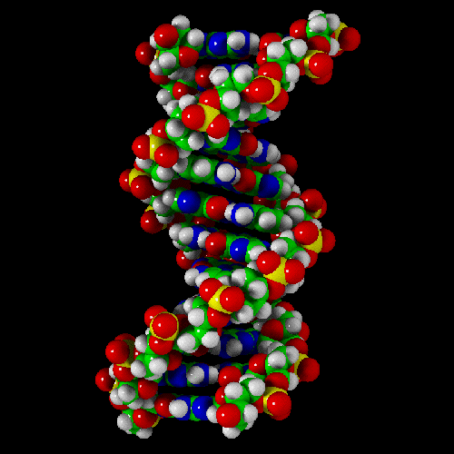
Unit 5. Its in your Genes

Slide 3
Homepage
Click underlined text below to go to exercises and information!
Materials List
Introduction
Exercise 1- Genes as segments of DNA
Exercise 2- Mendelian patterns of inheritance
  2a Basic Probability
  2b Law of Segregation
  2c Law of Independent Assortment
  2d Genotypes and Phenotypes
Exercise 3 – Epistasis
Exercise 4 – Human Genetics
Suggested Readings
Links
Click the house icon on slides where
present to return to this page!

Slide 4
Material List
Puzzle in box B
Molecular model building kit
Expandable DNA model
Blindfold
2 boxes (F, M) of 6 thin red and 6 thin white chips
2 boxes (IF, IM) each containing 3 thin red chips, 3 thick red chips, 3 thin white chips, 3 thick white chips
1 box (GP) of 6 blue chips, 6, red chips and 6 white chips
1 plastic petri dish (C)
4 ears of corn:
  2 parental ears (1 each of 2 different colors)
  1 F1 generation ear (with kernels all of a single color)
  1 F2 generation ear (with kernels of 2 colors)
  1 ear marked “Unknown Parentage”

Slide 5
Introduction
Perhaps the most important thing an organism does is to reproduce, or make copies of itself.
Each parent passes the traits it possesses on to its offspring through a process called heredity.
These traits may be:
  Morphological, such as eye color, bone structure and height
  Physiological, such as metabolic rate, growth rate, and digestion (assimilation) efficiency
  Behavioral, such as personality, quickness to respond to environmental cues, and attraction to mates offering particular traits
The materials and exercises in this box will help you to understand the process of heredity.

Slide 6
The student will…
Understand the process of heredity
by covering the topic of genes as segments of DNA
by exploring the basics of Mendelian patterns of inheritance

Slide 7
Exercise 1.
Genes are segments of a DNA molecule
Traits an organism possesses are programmed by genes.
  Genes are chemical codes consisting of a string of paired nucleotide bases that are positioned along the rungs of a structure that looks like a spiral staircase or twisted ladder.
Locate the DNA model and stretch it out by twisting the ends in opposite directions
  This is a model of a part of a DNA molecule whose structure can be seen only through an electron microscope (which magnifies objects 10,000+ times).
  Your DNA molecules strung out in a line would have a total length of about 1.7 meters (5.5 feet!).
  DNA is not in a single string, however, but rather occurs in several threadlike strands composed of DNA (complexed with proteins), called chromosomes, in the nucleus of each cell. Inside the nucleus of each human body cell, we have 46 chromosomes.
  Each chromosome contains many, many genes, with a single gene typically composed of a sequence or string of approximately 100,000 of pairs of nucleotide bases.

Slide 8
Exercise 1.
Genes are segments of a DNA molecule
Locate the DNA model and stretch it out by twisting the ends in opposite directions
  This is a model of a part of a DNA molecule whose structure can be seen only through an electron microscope (which magnifies objects 10,000+ times).
  Your DNA molecules strung out in a line would have a total length of about 1.7 meters (5.5 feet!).
  DNA is not in a single string, however, but rather occurs in several threadlike strands composed of DNA (complexed with proteins), called chromosomes, in the nucleus of each cell. Inside the nucleus of each human body cell, we have 46 chromosomes.
  Each chromosome contains many, many genes, with a single gene typically composed of a sequence or string of approximately 100,000 of pairs of nucleotide bases.

Slide 9
Q1: If each chromosome contains about 2 X 10⁸ nucleotide pairs, and a single gene typically is composed of a sequence or string of approximately 100,000 of these bases, then what is the approximate number of genes on each chromosome?
Click for the answer!
Answer: 200,000,000/100,000 = 2000 genes per chromosome

Slide 10
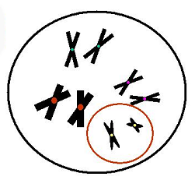
Each DNA molecule is located in the nucleus or computer of the cell. At certain times in a cell cycle, the DNA molecules can be seen as rod-like bodies called chromosomes (Fig. 1).
Most chromosomes are paired with an exact copy (are homologous). That is both members of the pair have the same genes located in the same place along the chromosome.
Only the sex chromosomes are non-homologous (do not share the same genes in the same place).
Fig. 1. Chromosome pairs in a nucleus
(non-homologous sex chromosome
pairs within red circle).

Slide 11
Question 2: How many pairs of homologous chromosomes (autosomes) are in the cell nucleus shown in Fig. 1?
Click for the answer!
Answer: 3 pairs
Question 3: What is the total number of chromosomes in this picture?
Click for the answer!
Answer: 8

Slide 12
Question 4: How many pairs of sex chromosomes (non homologous chromosomes) are in Fig. 1?
Click for the answer!
Answer: 1

Slide 13
The genes one parent passes on to its offspring may be the same or different than the ones the other parent provides.
  Genes for the same trait may differ chemically.
These chemical variants of a gene are called alleles.
The chemical differences occur as differences in the order or sequence of nucleotide base pairs on the rungs of the DNA ladder.
The differences between individuals and between the species of all organisms are determined by the sequences of nucleotide bases on the rungs of each DNA molecule.

Slide 14
Display the section of the DNA molecule you have expanded through twisting on a table at the front of the class.
Point out the following features of this model of DNA.
  The sides or backbone of the ladder are:
    sugar molecule (white)
    phosphate group (black)
  Four nitrogen bases form the rungs of the ladder and represent the genetic code or library which has only four letters:
      A for adenine (red)
      G for guanine (green)
      T for thymine (blue)
      C for cytosine (yellow)

Slide 15
The nitrogen bases in a DNA molecule each form a ring-like structure that consists of
  carbon atoms - C
  hydrogen atoms - H
  nitrogen atoms - N
  oxygen atoms - O
Thymine (blue in model) and Cytosine (yellow) are the smaller bases formed of single rings. They are referred to as pyrimidines.
Adenine (red in model) and Guanine (green), the purines, are the larger molecules, as each is formed of a double ring.
Figure 2 will help you to understand the structure you are looking at.

Slide 16
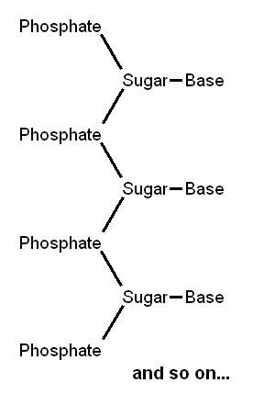
Fig. 2. One side of a DNA ladder: sugar-phosphate backbone with a sequence of bases sticking off

Slide 17
Objective
Exercise 1 familiarizes students with the structure, replication, and function of the DNA molecule.

Slide 18
Directions for Exercise 1a: DNA Structure & replication
Find box A that has a set of spherical shapes and connectors for use in building molecules.
Divide the class into 4 groups of students and have each group construct one of the nucleotide bases (A,G,T,C) using the molecular model set provided in Box A.
  Use the diagrams in Fig. 3 (next slide) as blueprints for this construction.
Each group should bring its model up to the front desk when finished, and make a label as to which base it is, and whether it is a purine or a pyrimidine.
Confirm that the purine bases are larger
than the pyrimidines.

Slide 19
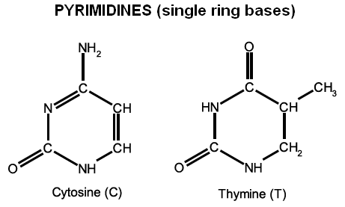
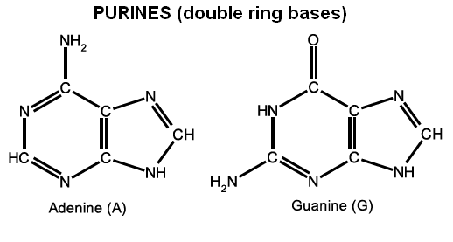
Figure 3. Blueprints for nitrogen bases that form the rungs of the DNA ladder.
Provide to
students as
handout!

Slide 20
Each of the lines connecting the carbon (C), nitrogen (N), oxygen (O), and hydrogen (H) atoms to other atoms in Figure 1.2 represent covalent bonds, which are bonds formed when atoms share a pair of electrons.
Double lines between two atoms denote two shared pairs of electrons between those two atoms.
Covalent bonds are very important within DNA molecules, as they not only hold the atoms making up each nitrogenous base together, but also are the types of bonds that keep the DNA “backbone” together.

Slide 21
Each pyrimidine base pairs with one of the larger purine bases (represented by double rings).
Have a student volunteer come up and start calling out the base pairs (color combinations) on each rung of the DNA model that has been unraveled on the front desk.
A second student should serve as scribe on the board at the front of the room.
A third student can make a second column on the board, translating the colors into the respective bases:
Where: Red = A for adenine, green = G for guanine, Blue = T for thymine & Yellow = C for cytosine
SAVE THIS LIST ON THE BOARD FOR LATER USE!
Question 5: What pattern(s) do you detect in the results presented on the board?
Stop!!! The Answer is next!!!

Slide 22
Answer:
1. Each single-ring base (pyrimidine) pairs only with a double ring (purine) base
The pyrimidine cytosine pairs only with the purine guanine, and the pyrimidine thymine pairs only with the purine adenine.
The fact that each base can pair only with one other base is called the Principle of Complementarity, and is important to DNA replication.
Locate the puzzle of a section of a DNA molecule in box B.
Have volunteers come up, each adding one piece to the puzzle until it is complete.
Examine the puzzle you have completed which should look like the one that follows.

Slide 23
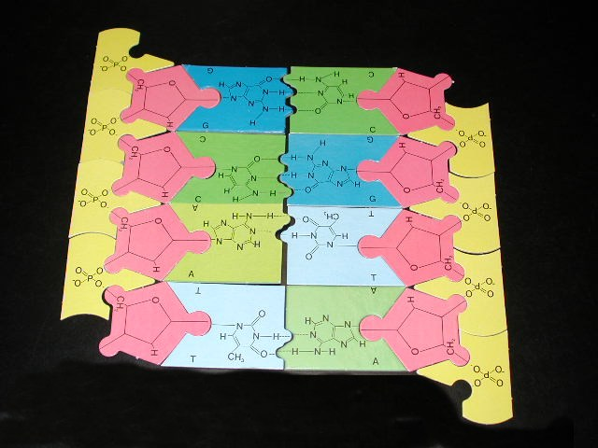
phosphate
sugar
guanine
cytosine
phosphate
sugar
adenine
thymine

Slide 24
Consulting the puzzle you have put together, have volunteers position each of the two models of base pairs in the proper orientation and connect them.
The types of bonds holding complementary base pairs together on the two strands of DNA that form the “ladder” are different from the covalent bonds discussed earlier.
The bonds that hold complementary base pairs together are called hydrogen bonds.
  Two hydrogen bonds are formed between adenine and thymine (A & T), and
  three hydrogen bonds are formed between cytosine and guanine (C & G).

Slide 25
Though hydrogen bonds do a good job of holding the two complimentary strands of DNA together when necessary, they are much weaker than covalent bonds.
The reason that this is important will be made clear in just a bit, when we discuss the process of DNA replication.

Slide 26
Answer the following questions.
Question 6: The total number of bases making up a gene will be variable, but which base will be present in the same amount as A (adenine) in a given DNA molecule?
Click for the answer!
Answer: Thymine
Question 7: Which base is present in the same quantity as G (guanine) in the DNA molecule?
Click for the answer!
Answer: Cytosine

Slide 27
Question 8: Here’s a more difficult question. You are a real scholar if you get it right! A (adenine) + C (cytosine) = ___ + ___ in a particular DNA molecule.
Click for the answer!
Answer: (A) Adenine + (C) Cytosine = (T) Thymine + (G) guanine

Slide 28
The Principle of Complementarity is extremely important to the duplication (replication) of genes during reproduction.
Briefly, the two strands (sides of the ladder) spread apart, separating the two complementary bases on each rung from each other.
  (This is where the relatively weak hydrogen bonds between complimentary base pairs comes in. It is important for the complimentary strands of DNA to be able to separate when it is time to replicate!)
Each base on a rung of the two single strands calls in a complement base.
The new strand formed, in each case, attaches to the original side of the ladder still present and each new DNA molecule twists in the characteristic helix.
Because each side of the original ladder does this, two exact copies are formed from the original single molecule.
Go to the next slides for an illustration of these steps.

Slide 29
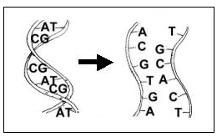
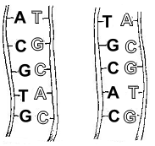
Fig. 4. During reproduction, DNA copies itself relying on the complementarity of its bases
Step 1. The two sides of the ladder (strands of DNA) split apart.
Step 2. Along each strand, a new
strand forms in the only
possible way.
Provide as handout

Slide 30
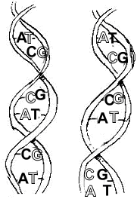
Step 3. Each new ladder twists into a helix, and we wind up with two copies of the original DNA molecule.
Each student should demonstrate this process on a piece of paper using an 8 base pair section of the DNA model taken from the list you made earlier on the board at the front of the room
Complete steps 1 and 2 from Fig. 4 for the DNA sample you have chosen.
To view Steps 1 & 2 again

Slide 31
Exercise 1b Function of DNA
The information in DNA is used by the cell.
It can be used and read over and over again.
  The information in the genes is read millions of times in the life of an organism, as it contains instructions for building molecules called polypeptides.
  Polypeptides include enzymes and other important proteins that work to perform the various biological functions of an organism.
Each gene holds the code for building one or more polypeptides. In short:
Thousands of nitrogenous bases make up one gene which may code for one or more polypeptides!

Slide 32
DNA Copying Errors Are Made! (Directions)
The teacher will write down a six base code such as ATGTAC.
She or he will whisper it to a student at the end of the first row.
This student will whisper it to his or her nearest neighbor and so on to the last person in the row.
The last person will write down the 6 letter code they heard.
The teacher will write on the board the original code and the code at the end.
In how many letter positions did the new code differ from the original?
You can repeat this process for each row of students so that they can compete to see which row makes the fewest copying errors.

Slide 33
Each change in the order or position of a particular letter in a code represents a mutation.
A mutation is a chemical change to DNA that produces variations that may cause gene products to be built differently, not built at all, or to be produced in different amounts.
This produces new alleles, or chemical variants of a gene, that may lead to the expression of new traits.
We calculate the rate of mutation as the number of base changes in a sequence of a particular length divided by the total number of bases in the sequence.

Slide 34
Have the students in each row calculate the mutation rate in their duplication experiment (whisper game result).
  First, divide the # of positions in the 6 letter sequence that have the wrong letter (a letter different from the original code) by six.
  Second, multiply the answer by 100 to obtain percent change.
  The equation for these calculations is :
  Percent Change = 100 (# bases changed/6)
  For example, If two bases were incorrect, your mutation rate would be 2/6 or 1/3. Your mutation rate was 0.33 and percent change = 33%.
Which row had the lowest mutation rate?
What was the average mutation rate for the class?
Average Mutation Rate = Sum Mutation Rates/# rows

Slide 35
Exercise 2. Patterns of Trait Inheritance
Examine the figure of the nucleus of an animal cell carefully below.
Close inspection shows that each chromosome, or DNA molecule has two copies.
  That is, they carry the same genes, though not necessarily the same alleles of each of these genes.
One chromosome is donated by the female parent and the other by the male parent.

Slide 36
Answer the following questions based on the figure:
Question 1: How many pairs of like (homologous) chromosomes does the cell model contain?
Click for the answer!
Answer: 3 pairs of like chromosomes
Question 2: How many chromosomes are there in all?
Click for the answer!
Answer: 8 chromosomes in all

Slide 37
Note that in most organisms, one pair of chromosomes do not look alike (i.e., are non homologous). These are the sex chromosomes, which govern the sexual characteristics of male and female offspring.
Locate the sex chromosomes in the model cell.
Question 3: How many sex chromosomes (non homologous) are there in Figure 1?
Click for the answer!
Answer: 2 sex chromosomes in the cell, or 1 pair.

Slide 38
In special germ cells (egg and sperm), the paired chromosomes (DNA molecules) are copied once, but the cell divides two times, producing 4 daughter cells instead of the one time producing two daughter cells that occurs in most cell types during a duplication event.
  In this way, each parent germ cell provides only a copy of one of its chromosomes in a pair to each daughter cell produced.
In carefully controlled experiments with pea plants in the 1800s, the Austrian monk Gregor Mendel contributed much of what we know today about the inheritance of traits known as the process of heredity.
We will use plastic disks and ears of corn instead of peas in examining trait inheritance patterns.

Slide 39
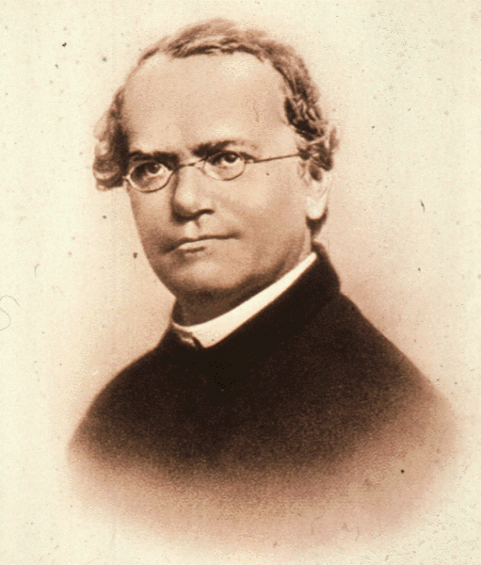
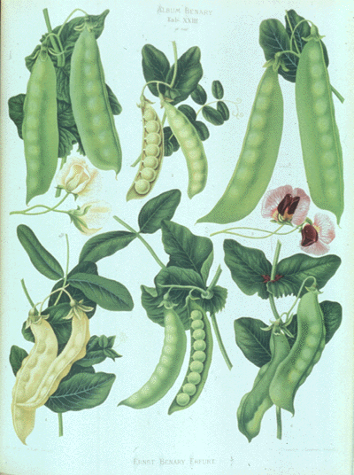
Objective
Exercise 2 allows students to investigate the laws of inheritance developed by Gregor Mendel.

Slide 40
Exercise 2a. Basic Probability
To every experiment there corresponds a set of possible outcomes, called the sample space of the experiment. We will denote the sample space of an experiment by the letter S. In our case, the experiment of interest is sexual reproduction. The sample space of this experiment is the set of all allele combinations that the resulting offspring could have.
Q1. Suppose that a man and a woman with genotypes Bb and BB reproduce. What is the sample space of this experiment?
Click for the answer!
The sample space of this experiment is {BB, Bb}, as these are the only two offspring genotypes that the parents with the given genotypes could produce.

Slide 41
Exercise 2a. Basic Probability
Q2. Suppose that a six sided die is rolled. What is the sample space of this experiment?
Click for the answer!
The sample space of this experiment is {1, 2, 3, 4, 5, 6}, as those are all possible results that could be rolled on the die.

Slide 42
Exercise 2a. Basic Probability
When the experiment of interest is sexual reproduction, we may use a special table called a Punnett square to find the sample space.
To construct a Punnett square, draw a two-by-two table.
Label the columns of the table with the father’s alleles, and the rows of the table with the mother’s alleles.
In each cell, record the allele at the beginning of the cell’s row and the allele at the top of the cell’s column.
For example if a man with genotype Bb and a woman with genotype Bb reproduce, then the corresponding Punnett square is the one pictured below.
 | B | b
B | BB | Bb
b | bB | bb

Slide 43
Exercise 2a. Basic Probability
 | B | b
B | BB | Bb
b | bB | bb
Note that the genotype Bb appears twice in the Punnett square from the example above. This is because there are two ways for these parents to produce such an offspring: The offspring will have genotype Bb if the father contributes a B allele and the mother contributes a b allele, or if the father contributes a b allele and the mother contributes a B allele. (Whether written as Bb or bB, the genotype is the same, as both situations reflect an offspring possessing one each of two different alleles!)

Slide 44
Exercise 2a. Basic Probability
Q3. Draw the Punnett square for the experiment from question Q1 (Parent genotypes are BB and Bb). Click for the answer!
The Punnett square shows all of the genotypes that the offspring may have (the sample space) and the number of ways that each genotype can be produced.
Q4. Use your Punnett square to find the number of ways that each of the offspring genotypes from question Q1 can be produced. Click for the answer!
In this scenario, the offspring genotype BB can be produced two ways, and the offspring genotype Bb can be produced in two ways in this cross.
 | B | b
B | BB | Bb
B | BB | Bb

Slide 45
Exercise 2a. Basic Probability
A subset of the sample space is called an event.
To be more specific, an event is a set that contains some (possibly all) of the experiment’s outcomes. In the previous example, the set E = {Bb, BB} is an event.
Note that the order in which we list the elements in the set does not matter. This means that the sets {Bb, BB} and {BB, Bb} are considered to be the same.
There are many ways to describe the event E with words. For example, we might say that E is the event that the child has at least one B allele.
Q5. Can you think of any other ways to describe the event E? Click for the answer!
Another possible way to describe the event E is the event that a child has at most one b allele.

Slide 46
Exercise 2a. Basic Probability
The sets {Bb}, {BB}, {bb}, {BB, bb}, {Bb, bb}, and {Bb, BB, bb} are other possible events for this experiment.
Events such as {bb}, which contain a single element are called elementary events.
If two events contain none of the same elementary events then they are said to be mutually exclusive events.
  For example, {Bb, BB} and {bb} are mutually exclusive events.
Q6. Suppose that you roll a six sided die. Let E denote the event that you roll less than a five. Write down all of the elements that belong to the event . Click for the answer!
E = {1, 2, 3, 4}

Slide 47
Exercise 2a. Basic Probability
Q7. Let B be the event that you roll 1, 4, or 6, that is, let B = {1, 4, 6}. Are B and E mutually exclusive? If not, which elementary events belong to both B and E?
Click for the answer!
B and E are not mutually exclusive, because {1} and {4} are elementary events in both B and E.

Slide 48
Exercise 2a. Basic Probability
Q8. Find three possible events of the experiment in question Q1. Also find a pair of mutually exclusive events. Click for the answer!
{BB}, {BB, Bb}, and {Bb} are three events that belong to the experiment in question Q1. {BB} and {Bb} are mutually exclusive.

Slide 49
Exercise 2a. Basic Probability
The probability that any specific event occurs measures the likelihood that the event occurs.
If E is an event, then we denote the probability that E occurs by P(E).
Sometimes the probability that an event occurs can be determined through intuition. At other times it may be determined experimentally.
There are three basic axioms (rules) of probability that are used to determine the probability that an event occurs.
We will explore these basic axioms of probability on the next slide.

Slide 50
Exercise 2a. Basic Probability
Axioms of Probability
  If S is the sample space of an experiment, then P(S) = 1.
  If E is any event, then 0 ≤ P(E) ≤ 1.
  If A and B are mutually exclusive events, then P(A or B) = P(A) + P(B).

Slide 51
Exercise 2a. Basic Probability
Axioms of Probability
Below are verbal explanations of each of the axioms above, which may assist in understanding exactly what they mean:
  The sample space S of an experiment is the set of all possible outcomes. One of the outcomes in the sample space will definitely occur.
  The likelihood of a particular event ranges from impossible to absolutely definite. (Probabilities are usually expressed as fractions, or more commonly, decimals, ranging from 0, or 0% likely, to 1, or 100% likely.)
  If an outcome can be one of two alternatives (but not both), the probability of either event occurring is equal to the sum of the likelihood of each event’s occurrence.

Slide 52

Exercise 2a. Basic Probability
A couple of very useful rules follow directly from the axioms of probability.
Rule 1: If all of the outcomes in the sample space are equally likely to occur, then the probability that any specific event, E, occurs is the ratio of the number of outcomes that belong to E divided by the total number of outcomes in the sample space.
  For example, suppose that you roll a fair six-sided die. Since the die is equally likely to land on any of its sides, we can use Rule 1 to find the probability that any event occurs. The probability that the event B = {1, 4, 6} occurs is

Slide 53
Exercise 2a. Basic Probability
Q9. Suppose you have three pennies in your pocket. One was made in 1991, another was made in 1985, and the third was made in 2006. Suppose that you pull one penny from your pocket without looking. Are you equally likely to pick any of the pennies? Explain why or why not. Click for the answer!
Yes, you are equally likely to pick any of the pennies, because they all have the same size and shape.

Slide 54
Exercise 2a. Basic Probability
Q10. What is the probability that you pick the penny from 1985? What is the probability that you don’t pick the penny from 1985?
Click for the answer!
Since there is only one way of drawing the 1985 penny, and three possible outcomes, the probability that you pick the 1985 penny is 1/3. The probability that you don’t pick the penny from 1985 is 2/3, since there are two outcomes out of the total 3 that don’t involve drawing the 1985 penny.

Slide 55
Exercise 2a. Basic Probability
Remember, if a gene is located on an autosome, then an animal has two alleles of this gene.
Each parent gives only one of these alleles to its offspring.
In fact, a parent is equally likely to give either of these alleles to its offspring.
As a result, when we draw a Punnett square, each cell of the square is equally likely to happen.
Therefore, we can determine the probability that the offspring has a specific genotype by completing a three step procedure:
  Draw the Punnett square.
  Count the number of cells in which the genotype of interest appears.
  Divide the number from Step 2 by the total number of cells in the Punnett square.

Slide 56
Exercise 2a. Basic Probability
Example: Suppose that a woman and a man with genotypes and reproduce. What is the probability that their child has genotype Bb?
First we draw the Punnett square.
Next we count that the genotype Bb appears in 2 cells. (Note that the order in which the alleles are listed does not affect the genotype, that is, the genotype Bb is the same as bB.)
Thus, the probability that their child has the genotype Bb is equal to 2/4, which is equal to ½.
 | B | b
B | BB | Bb
b | bB | bb

Slide 57
Exercise 2a. Basic Probability
Q11. Suppose that a woman and a man with genotypes Bb and BB reproduce. What is the probability that their child has genotype BB?
Stop! The answer is next!!!
First, again, we draw the Punnett square.
In this case, the genotype BB appears in 2 cells.
Thus, the probability that their child has the genotype BB is equal to 2/4, which is equal to ½.
 | B | b
B | BB | Bb
B | BB | Bb

Slide 58
Exercise 2a. Basic Probability
Suppose that E is an event. The event that E does not occur is denoted by Ē.
Rule 2: If E is an event then P(Ē) = 1 – P(E).
In other words, the likelihood that an event does not occur is equal to 1 (100%) minus the chance that the event does occur.
Q12. Remember the couple (with genotypes Bb and BB) from Q11? Use Rule 2 to find the probability that their child does NOT have genotype BB.
Stop! The answer is next!
Since the probability that their child has the genotype BB is equal to ½ , the probability that their child does NOT have the genotype BB is equal to 1 – ½ = ½.

Slide 59
Exercise 2a. Basic Probability
One more probability concept is very important to heredity.
This is the concept of independence.
Two events are independent if the occurrence of one event does not affect the probability that the other event will occur.
For example, if we roll two dice, the outcome of the first roll does not affect the outcome of the second roll.
Therefore, if we let A be the event that the first die lands on a 6, and B be the event that the second die lands on a 3, then the events A and B are independent.
When two events are independent, the probability that both events occur is equal to the product of the probabilities that each event occurs.
In other words, if A and B are independent events, then P(A and B) = P(A)P(B)
The converse is also true. That is, if the probability that both events occur is equal to the product of the probabilities that each event occurs, then the events are independent:
If P(A and B) = P(A)P(B), then A and B are independent events.

Slide 60
Exercise 2a. Basic Probability
Q13. Suppose two coins are tossed. Let A be the event that the first coin is heads, and B be the event that the second coin is heads. Are A and B independent?
Stop! The answer is next!
Yes, A and B are independent, because the outcome of the flip of the first coin does not affect the outcome of the flip of the second coin. In mathematical terms,
P(A and B) = P(A)P(B)
Q14. Suppose that two children attend the same daycare. Let A be the event that the first child catches a cold and B be the event that the second child catches a cold. Are the events A and B independent?
Stop! The answer is next!
No, A and B are NOT independent, because the probability that the second child gets a cold is increased by the fact that the first child got a cold, since they both attend the same daycare!

Slide 61
Exercise 2a. Basic Probability
Q15. Find the probability that A and B occur, where A and B are the events from Q13 (the result of the flip of the first coin is heads, and the result of the flip of the second coin is also heads). Click for the answer!
P(A and B) = P(A)P(B) = ½ × ½ = ¼
In carefully controlled experiments with pea plants in the 1800s, the Austrian monk Gregor Mendel learned much of what we know today about the process of heredity. We will use plastic disks and ears of corn to explore trait inheritance patterns in the next two exercises.

Slide 62
Exercise 2b. Law of Segregation – Alleles of genes are randomly assigned to offspring
Find plastic boxes F (for female parent) and M (for male parent) holding red and white plastic chips in them.
Each box should contain an equal mix of 6 red and 6 white chips. That is, your parents each had one chromosome of a chromosome pair with a chemical variant (allele) of the color gene that produced a red colored chip while the other chromosome had an allele that produced a white colored chip. The parents are heterozygous for chip color.
Their genotypes were CC’/C’C’ where C = the red allele and C’ the white allele of the gene for chip color.
Note that the order of presentation (CC’ or C’C) does not matter.
Have a student check to make sure that there are equal numbers of red and white chips in each of the boxes.

Slide 63
Exercise 2b. Law of Independent Segregation Directions (continued)
Place the female parent box (F) on one side of a desk at the front of the room and the male (M) on the other side of this desk.
Have the first row of students form a line by the front table so that each will have a turn to make the random choice of traits the offspring of the two heterozygous parents will produce.
The 1st student will put on a blindfold, remove one chip from each box F and M and place each chip in front of the dish from which it was drawn.
After taking off the blindfold, the student will call out the two alleles for the offspring he/she has produced (e.g. CC or red red) to a scribe filling in a table at the board in front of the room. See table template on next slide.
The student will replace the chips in the respective parent boxes and hand the blindfold to the next individual in line.
Repeat this process until all students have had a chance to produce offspring with a set of two alleles for each of the two traits.

Slide 64
Offspring # | Female Parent Contribution* | Male Parent Contribution*
1
2
3
4
5
6
7
8
9
10
*Potential contributions
(Gametes):
C = red allele
or
C’ = white allele

Slide 65
Exercise 2b. Law of Independent Segregation Directions (continued)
Q1. What is the probability that you drew a red allele from the female parent box? Explain how you came to this answer. Click for the answer!
The probability that you drew a red allele from the female parent box is equal to ½. This is because there are only two possible outcomes: either a red allele, or a white allele, and there are equal numbers of chips representing each allele in the female parent box.

Slide 66
Exercise 2b. Law of Independent Segregation Directions (continued)
Q2. Suppose that when choosing the genotype of the first offspring, you drew a red chip from the female parent’s box, and did not replace this chip before the second draw. What is the probability that the second offspring receives a red allele? Click for the answer!
Since there are 12 total chips in the box, after removing one red chip, this leaves 11 possible chips (5 red and 6 white) for the next draw. Thus, the probability that the second offspring would receive a red allele is equal to 5/11.
However, we replace the chips after each selection because an individual is equally likely to receive either of his or her mother’s alleles and either of his or her father’s alleles. In general, each time an organism reproduces, it is equally likely to donate either of its alleles for a given gene to its offspring.

Slide 67
The genotype of any given offspring might be CC, C’C’, or CC’ or C’C, though C’C and CC’ are identical, as it does not make any difference which parent donated the chromosome containing the gene for a particular chip color to the offspring.
When the two chromosomes an individual has for a particular gene have the same allele for a trait, they are said to be homozygous for that trait.
  Your offspring with CC or C’C’ are homozygous.
The parents in our experiment had one white allele and one red allele. They were heterozygous for the traits.
  Your offspring with CC’ or C’C are heterozygous.
The particular trait an offspring inherits from his parents is not related (independent) to the traits his siblings (sisters or brothers) have received. This is why we have to put the chips back after each selection.
If the parents have one chromosome for each color, the probability that they will donate a red allele (C) is 50% or ½ and the probability that they will donate a white allele (C’) 50% for each offspring they produce just as heads or tails will come up 50% of the time in a coin toss.

Slide 68
Exercise 2b. Law of Independent Segregation
Directions (cont.)
Count the number of offspring of the three combinations of chips you have obtained: CC, C’C’ CC’ or C’C. Each of these is a genotype.
Calculate the percent of each genotype represented by dividing the count by the number of offspring produced (students making a blindfold choice) and multiplying by 100, as in the example below.
% Frequency of genotype C’C’ =
100(# offspring _{C’C’}/total number of offspring)

Slide 69
Exercise 2b. Law of Independent Segregation Directions (cont.)
Geneticists use a chart called a Punnett square to determine what frequencies of offspring two parents will produce when their genotypes are known.
The Punnett square for the offspring of the cross of two parents that are heterozygous for chip color is presented below.
Note that each allele each parent can offer is positioned above a column for one parent and along a row for the other.
The cells in the chart are then just filled in by pulling down the letter from the parent above and across for the parent to the side.
Frequency of offspring genotypes: (1 cell) ¼ CC, (1 cell) ¼ C’C’, (2 cells) ½ CC’.
 |  | Male parent
 |  | C | C’
Female parent | C | CC | CC’
 | C’ | C’C | C’C’

Slide 70
Exercise 2b. Law of Independent Segregation Directions (cont.)
Q3. Based on the probability that an individual has genotype CC, how many offspring from your total # of offspring would you expect to have genotype CC? What about CC’ and C’C’? Click for the answer!
According to the laws of probability, the expected frequencies would be 25% (1/4) CC, 25% (1/4) C’C’, and 50% (1/2) mixed C and C’.
Find the frequency of each genotype in your actual data, and record your answers.

Slide 71
Exercise 2b. Law of Independent Segregation Directions (cont.)
Find the frequency of each genotype in your actual data, and record your answers.
Q4. How close are the actual frequencies to the frequencies that you predicted based on probability? Why wouldn’t they be the same?
Click for the answer!
Your actual frequencies are probably not equal to the predicted frequencies because the probability that an outcome occurs only measures how likely it is that the outcome occurs, not what fraction of the time the outcome actually will occur.

Slide 72
Exercise 2b. Law of Independent Segregation Directions (cont.)
Q5. Find the probability that an individual offspring is NOT homozygous white. Click for the answer!
Since both parents have the genotype CC’ (both are heterozygous), each has a probability of ½ of donating the C’ (white) allele.
Therefore, the probability of an offspring being homozygous white is equal to the probability of getting a white allele from both the male and female parents.
Using the rules of probability, this would be equal to
½ × ½, or ¼
However, we are interested in the probability that an individual offspring does NOT have the genotype C’C’.
Also using the rules of probability, we can calculate this probability as P(NOT C’C’) = 1 – P(C’C’) = 1 – ¼ = ¾
We could have also gotten this from our Punnett square by dividing the # of cells in which the offspring is NOT genotype C’C’ (3) by the total # of possible outcomes (4).

Slide 73
Repeat this experiment using one parent that is homozygous for the red chip color and the other parent homozygous for the white color. Complete a Punnett square analysis of the results on a sheet of paper.
Repeat this experiment using one parent that is homozygous for the red chip color and the other parent heterozygous (CC’). Complete a Punnett square analysis of the results on a sheet of paper.
 |  | Male parent gametes
Punnett Square
Template for
1 gene/trait
Female parent gametes

Slide 74
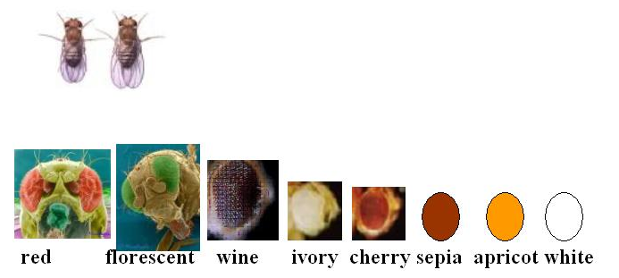
Exercise 2b. Mendel’s Law of Independent Segregation: Multiple alleles.
We need to consider one more thing before leaving Mendel’s Law of Independent Segregation.
Genes do not come only in two chemical variants/alleles.
  Human blood types have three alleles: A, B, and O.
  Eye color in fruit flies have many more alleles (Fig. 2).
Fig. 2. Multiple alleles for eye color in fruit flies. Each of the colors below is produced by a different allele of the same gene for eye color.

Slide 75
Exercise 2b: Law of Independent Segregation
with Multiple Alleles (Directions)
How are traits inherited when there are multiple alleles?
In this experiment, you will be examining the offspring produced in a population for which there are 3 alleles for chip color.
Each parent can only possess 2 of these 3 alleles, as it has only 2 homologous chromosomes for this trait. Thus, you will need to determine the male and female parent’s genotype before producing your offspring.

Slide 76
Exercise 2b: Law of Independent Segregation
with Multiple Alleles (Directions)
Find the box labeled GP, which represents a population’s gene pool. It has 8 chips of each of three colors (red C, white, C’ and blue C’’). Spread these chips out on the table at the front of the room.
Line the first row of students up at the front table.
The test student places a blindfold on and removes two chips from the table and the next student in line places these in the dish (F) corresponding to the female parent.
Repeat the draw from the table, selecting the male parent’s two alleles. Deposit these in the dish (M)

Slide 77
Exercise 2a2: Law of Independent Segregation
with Multiple Alleles (Directions, cont.)
The blindfolded student should pick one chip from each of the two containers F and M, determining female and male parents’ contributions to their offspring.
After taking off the blindfold, the student will call out the two alleles for the offspring he/she has produced to a scribe filling in a table at the board in front of the room. See table template on next slide
He or she then returns the 4 chips to the table and mixes the chips on the table as the next student places on the blindfold.
Repeat this process until all students have had an opportunity to select the parental genotypes and their offspring’s genotype.
Calculate the frequencies of different genotypes you will see in the offspring of this population where:
Frequency of particular genotype =
100 (# offspring of that genotype/total number of offspring)
Note: Be sure to put all 8 chips of each color back in the GP box and close it with the rubber band provided when you are finished.

Slide 78
Offspring # | Female Parent Contribution* | Male Parent Contribution*
1
2
3
4
5
6
7
8
9
10
*Potential Contributions
(Gametes)
C = red allele
or
C’ = white allele
or
C’’ blue allele

Slide 79
What have you learned?
Despite the fact that there may be many different alleles for a gene present in a population’s gene pool, any parent can only possess, at most, two different alleles.
  Each parent has only two copies of a given chromosome, with only one allele of a gene on each copy.
  The two alleles a parent possesses may be the same (parent is homozygous for the trait) or different (parent is heterozygous for the trait) chemical variants of the gene.
The different alleles are mutations that are present in a population (individuals living and breeding in the same locality) of a species or the species as a whole.

Slide 80
Exercise 2c. Mendel’s Law of Independent Assortment
Our Austrian monk Mendel also experimented with his pea plants to see if different traits such as plant height and flower color were inherited together (linked), or were inherited independently.
  To help visualize this, think of buying a car. You might like a particular car’s front end but not the shape of its trunk area. However, the two are linked, and you have to take the rear end with the front.
Let’s use a chip example to investigate this problem. We will use red chips and white chips to represent color and fat and thin chips to represent size. Find the boxes IF and IM.

Slide 81
Exercise 2c1. Tree diagrams & the counting principle
In our previous experiments, we used probability to analyze the way an offspring inherits a single trait.
So, our previous experiment consisted of only two steps or tasks.
  The first task was to pick the allele from the female parent.
  The second task was to pick the allele from the male parent.
It was easy to list and count all of the possible outcomes. In the next experiment, however, we will use probability to analyze how an offspring inherits multiple traits.

Slide 82
Exercise 2c1. Tree diagrams & the counting principle
The next experiment thus consists of many more tasks, and has many more outcomes.
When an experiment consists of multiple tasks, tree diagrams and the counting principle are useful ways to determine the probability of an event.

Slide 83
Exercise 2c1. Tree diagrams & the counting principle
The counting principle
If there are x ways to perform one task, and y ways to perform a second task, then there are xy ways to perform both tasks.
Suppose for example that we flip two coins. Then there are 2 possible results from the flip of the first coin (heads or tails), and 2 possible results from the flip of the second coin, so there are 2×2=4 possible results when flipping both coins.
Q1. Suppose that you have three shirts (green, orange, and yellow) and two pairs of pants (blue and brown). How many different outfits can you assemble from these clothing items? Click for the answer!
Since there are 3 different choices of shirts, and 2 different choices of pants, there are 3 × 2 = 6 different outfits that you can assemble from the given wardrobe.

Slide 84
Exercise 2c1. Tree diagrams & the counting principle
A tree diagram is a visual aid that helps us find and count all the possible outcomes of an experiment. For example, we can construct a tree diagram for the experiment from Q1.
A tree diagram can help us to find the probability that an event occurs. Suppose you get up in the morning and grab a shirt and a pair of pants without looking. What is the probability that your shirt is yellow? Click again for the answer!
Answer: Since you don’t look, you are equally likely to grab any of the shirts or pants in your closet, so the probability that your shirt is yellow is equal to the # of outcomes with a yellow shirt divided by the total # of outcomes. There are 2 possible outcomes with a yellow shirt and 6 outcomes total, so the probability that your shirt is yellow is 2/6=1/3.
orange
yellow
green
blue
white
blue
white
blue
white
green,blue
green, white
orange, blue
orange, white
yellow, blue
yellow, white

Slide 85
Exercise 2c1. Tree diagrams & the counting principle
orange
yellow
green
blue
white
blue
white
blue
white
green,blue
green, white
orange, blue
orange, white
yellow, blue
yellow, white
Suppose you get up in the morning and grab a shirt and a pair of pants without looking. What is the probability that your shirt is yellow? Click again for the answer!
Since you don’t look, you are equally likely to grab any of the shirts or pants, so the probability that your shirt is yellow is equal to the # of outcomes with a yellow shirt divided by the total # of outcomes. There are 2 outcomes with a yellow shirt and 6 outcomes total, so the probability that your shirt is yellow is 2/6=1/3.

Slide 86
Exercise 2c1. Tree diagrams & the counting principle
Q2. What is the probability that your shirt is yellow or orange?
Stop! The answer is next!!!
There are 2 out of the total 6 possible outcomes with a yellow shirt, so P(yellow) = 2/6 = 1/3
There are also 2 out of the possible 6 outcomes with an orange shirt, so P(orange) = 2/6 = 1/3
Remembering our rules of probability, the probability of getting a yellow shirt OR an orange shirt would thus be given as
P(yellow OR orange) = P(yellow) + P(orange) = 1/3 + 1/3 = 2/3
We could have also obtained the same result by counting together all of the outcomes in which a yellow shirt or an orange shirt was obtained (a total of 4/6, which also equals 2/3).

Slide 87
Mendel’s Law of Independent Assortment: 2-trait analysis
Make sure each box, IF & IM has 3 thin red chips (genotype: TC, 3 thick red chips (genotype: T’C), 3 thin white chips (genotype: TC’) & 3 thick white chips (genotype: T’C’) in it.
Place these boxes open with space between them on a table at the front of the room.
Have the first row of students line up at this table.
The first student will put on the blindfold and pick one chip out of the IF box (female gamete contribution) and 1 chip from the IM box (male gamete contribution) and place these on the table in front of the box.
After taking off the blindfold, the student will call out the two alleles for each trait the offspring he/she has produced to a scribe filling in a table at the board in front of the room (e.g. thick red from female parent & thick white from male parent). (Table template on next slide).

Slide 88
Directions continued
Offspring # | Female Parent Contribution* | Male Parent Contribution*
1
2
3
4
n
The student will replace the chips in the respective parent boxes and hand the blindfold to the next individual in line.
Repeat this process until all students have had a chance to produce offspring with a set of two alleles for each of the two traits.
Potential gametes (parent contributions):
CT (Red Thin), CT’ (Red Thick),
C’T (White Thin) & C’T’ (White Thick)

Slide 89
Mendel’s Law of Independent Assortment: 2-trait analysis
In the previous experiment, each parent had four alleles total: two alleles for color, and two alleles for size. In order for these parents to produce an offspring, four tasks must be completed:
  The mother must donate an allele for color to the offspring.
  The mother must donate an allele for size to the offspring.
  The father must donate an allele for color to the offspring.
  The father must donate an allele for size to the offspring.
Q1. How many ways can each of these tasks be performed?
Stop! The answer is next!
Each of the previous tasks can be performed in 2 ways.
Q2. How many possible outcomes are there to this experiment?
Stop! The answer is next!
Since each task could be performed in two ways, and there were 4 tasks total, the number of possible outcomes is equal to 2 × 2 × 2 × 2 = 16 possible outcomes.

Slide 90
Mendel’s Law of Independent Assortment: 2-trait analysis
Construct a tree diagram showing all possible outcomes from the cross of two parents that are both heterozygous for both color and thickness.
In the tree diagram, the first branch point represents the possible alleles for color donated by one parent.
The next set of branches represents the possible alleles for color donated by the other parent, given the allele for color donated by the first parent.
The next set of branches represents possible alleles for thickness donated by one parent, given the alleles donated by both parents for color.
The final set of branches represents the possible alleles for thickness donated by the other parent, given the alleles donated by both parents for color, and the allele for thickness donated by the first parent.
The outcomes after the arrows represent the genotypes of the offspring in each scenario.
Note that some offspring genotypes could occur several different ways!
C'
C
C'
T
T'
T→CCTT
T'→CCTT'
T→CCTT'
T'→CCT'T'
C
C'
T
T'
T→CC'TT
T'→CC'TT'
T→CC'TT'
T'→CC'T'T'
T
T'
T→C'C'TT
T'→C'C'TT'
T→C'C'TT'
T'→C'C'T'T'
T
T'
T→CC'TT
T'→CC'TT'
T→CC'TT'
T'→CC'T'T'
C

Slide 91
Directions continued
Calculate the frequency of the different offspring genotypes the class produced.
Frequency of particular genotype =
100 (# offspring of that genotype/total # of offspring)
How closely do your frequency results compare to the Punnett square predictions for independent inheritance of the two traits?
The Punnett square genotype frequency predictions are based on the idea that the two traits color and chip thickness are inherited independently.
Do the class results suggest that this is true?
Your results should suggest that in this case, the two traits ARE inherited independently!

Slide 92
Q3. How many possible genotypes could the offspring produced by this cross have? (Remember that the genotype is the set of alleles that an individual has with no regard to which parent donated which allele.) Click for the answer!
Though there are a total of 16 possible outcomes when considering which allele came from each parent, there are only nine possible genotypes (some of which can be achieved in multiple ways) from a cross of two parents heterozygous at two loci. In this case, the possible genotypes are CCTT, CCTT’, CCT’T’, CC’TT, CC’TT’, CC’T’T’, C’C’TT, C’C’TT’, and C’C’T’T ’.

Slide 93
Q4. Let A be the event that the offspring has at least one C allele, and B be the event that the offspring has at least one T allele. Use the tree diagram to find P(A), P(B), P(A and B), and P(A)P(B). Do your answers support Mendel’s Law of Independent Assortment? That is, do they support the hypothesis that alleles for the color and thickness genes are inherited independently? Explain why or why not. Click for the answer!
You should find that P(A and B) = P(A)P(B). Recall that this is equivalent to the statement that the events A and B are independent.

Slide 94
In nature, Mendel’s Law of Independent Assortment is true:
  if the two genes are located on different chromosomes
  if the two genes are located far apart on the same chromosome (because homologous chromosomes tend to exchange pieces that touch)
However, if the two genes are very close to one another on the same chromosome, they tend to be inherited together, and the traits are said to be linked.

Slide 95
Example of how to complete a Punnett square analysis for inheritance of 2 traits, color with the two alleles - C (red) and C’ (white); and thickness with the two alleles - T (fat) and T’ (thin).
Male parent genotype CC’TT’
Female
parent
Genotype
CC’TT’
 | CT | CT’ | C’T | C’T’
CT | CCTT’ | CCT’T’
CT’ | CCT’T’
C’T | C’CTT’
C’T’ | C’CT’T
Finish filling out this square & calculate the frequencies of the different offspring genotypes:
Frequency of particular genotype =
100 (# offspring of that genotype/total # of offspring)

Slide 96
Exercise 2d. There are genotypes and then there are phenotypes.
Thus far we have talked only about the genes that underlie traits and how these genes are inherited.
The genotype refers to the specific alleles of a gene an individual possesses.
Genes are not observable without the use of molecular tools.
The observable traits of an organism are referred to as its phenotype.
The phenotype of a homozygous individual for red color, CC, is red and the phenotype of an individual that is homozygous for white, C’C’ is white. But what about the individual who is heterozygous for these two colors, CC’ or C’C?
If the traits are of equal influence, we might expect the individual to exhibit some intermediate between red and white as in pink.

Slide 97
Mendel discovered that when he crossed peas with purple flowers with those having white flowers, the offspring all had purple flowers.
  The purple allele (chemical variant) was dominant over the white allele.
  Therefore, an allele that masks the effect of another allele is called a dominant allele and assigned a capital letter to it (C).
  The allele whose effect was not observed in the presence of the dominant allele is termed a recessive allele and it is demarcated as a lower case letter corresponding to the capital letter of the dominant allele, c.

Slide 98
Thus if red in our chip system was dominant over white, the phenotype of CC = red, of cc = white and of Cc = would be red, as well.
To demonstrate the phenotypic expression of genes that show dominance/recessive relationships, we will examine the offspring (progeny) of corn plants.
Here the offspring are the individual kernels of an ear of corn because each kernel of corn could be planted and give rise to a corn plant.

Slide 99
The trait we will be examining in the wild corn species, Zea mays, is kernel color. Though kernels may occur in many colors, you will be examining ears that display kernels of two possible different colors.
The teacher will hold up two ears of corn representing one parental ear that is all one color, and another parental ear that is all a second color.
Because these ears of corn were specially grown for scientific purposes, we know that each parental ear is homozygous for the color it exhibits. That is, each kernel on each parental ear has two of the same alleles for the color that is observed.
We thus could possibly have one of three relationships between the alleles for kernel color in this system:
  1. CC = color 1 & C’C’ = color 2 (no dominance between alleles)
  2. CC = color 1 (dominant) cc = color 2 (recessive)
  3. CC = color 2 (dominant), cc = color 1 (recessive)

Slide 100
Examining the color of an ear of corn resulting from the cross of the two parental types will provide an answer as to which of the three possibilities underlies kernel color.
Your teacher will now show the class ear marked as F1 offspring of the cross between the homozygous parent plants.
Question:Which of the the three underlying genetic relationships shown again below will produce an offspring that has only kernels of color 1? Have a class vote:
  1. CC = color 1 & C’C’ = color 2 (no dominance between alleles)
  2. CC = color 1 (dominant) cc = color 2 (recessive)
  3. CC = color 2 (dominant), cc = color 1 (recessive)
  Click for the answer!
  2. CC = color 1 (dominant) cc = color 2 (recessive)
The phenotype of the F1 offspring of CC & cc parents is color 1, but the genotype is Cc, heterozygous for color.

Slide 101
Complete a Punnett square analysis to show the relationship between genotype and phenotype for the the F2 generation produced by heterozygous offspring.
  The teacher will work this out on the board as the students indicate what alleles go into each cell
 | C | c
C
c
Question: What is the expected frequency of the color 1 PHENOTYPE in the F2 generation (cross between two heterozygous parents?
Click for the answer!
3/4 color 1

Slide 102
Question:What are the frequencies of the two genotypes underlying the color 1 phenotype as a result of this cross? Click for the answer!
1/2 Cc heterozygous & 1/4 CC homozygous
Find the ear of corn that was produced by heterozygous Cc x Cc parents.
Pass the ear of corn around the class with each pair of students reporting to their teacher the number of kernels of both color 1 and color 2 in a circular row they choose at random on this ear.
The teacher will summarize these data on the board so that the class can calculate the frequencies of color 1 and color 2 phenotypes.
Do your counts fit the Punnett square expectation of 3/4 color 1 and 1/4 color 2 in an ear of corn produced by heterozygous Cc x Cc parent corn plants?

Slide 103
What have we learned from examining traits that have dominant/recessive relationships? Because of dominant/recessive relationships between alleles:
  Recessive traits appear to be lost in some generations.
  They are not lost, but rather are merely not visible (not outwardly expressed) in the heterozygous individual.

Slide 104
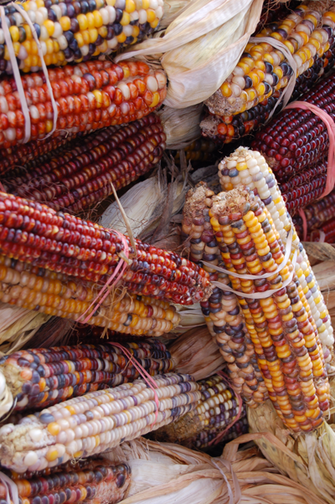
Exercise 3 - Epistasis
In this exercise, you will learn about the phenomenon of epistasis, or the interaction between genes, and how such interactions can affect phenotypes of organisms, using the corn from Exercise 2d as a model.
As you can see in the picture at the right, kernels of corn can come in many shades, but basically can be classified into four major colors: purple, red, yellow, and white.
The color of a corn kernel is determined by the interactions between four different genes that affect pigment production.

Slide 105
Exercise 3 - Epistasis
To understand a little bit about how interactions between genes determine corn kernel color, first we should understand a little bit more about the structure of corn kernels themselves.
Look at the diagram to the right, which displays the parts of a kernel of corn.
The pericarp, or outer covering of the kernel, is colorless. Rather pigment production occurs in both the aleurone, the layer below the pericarp and in the endosperm, the nutrient supply for the developing corn plant embryo.
From Ford, R.H. 2000. Inheritance of kernel color in corn: Explanations & investigations. The American Biology Teacher 62(3):181-188.

Slide 106
Exercise 3 - Epistasis
  Three genes determine the color (pigmentation) of the aleurone layer:
    Red Aleurone 1 gene, which has two alleles - P & p
    Colored Aleurone 1 gene, which has three alleles - C, C’, & c
    Colored1 gene, which has two alleles- R & r
  If a kernel is homozygous recessive for any one of these genes, or if a kernel has at least one C’ allele, the aleurone of the kernel is also colorless, like the pericarp.
From Ford, R.H. 2000. Inheritance of kernel color in corn: Explanations & investigations. The American Biology Teacher 62(3):181-188.

Slide 107
Exercise 3 - Epistasis
A fourth gene affects pigmentation in the endosperm:
  White 1 gene, which has two alleles - Y & y
  A kernel that is homozygous recessive (yy) will have white endosperm, while a kernel that is heterozygous (Yy) or homozygous dominant (Yy) will have yellow endosperm.
The tree diagram on the next slide will give you an overview of how these genes interact to determine color in a kernel of corn.
From Ford, R.H. 2000. Inheritance of kernel color in corn: Explanations & investigations. The American Biology Teacher 62(3):181-188.

Slide 108
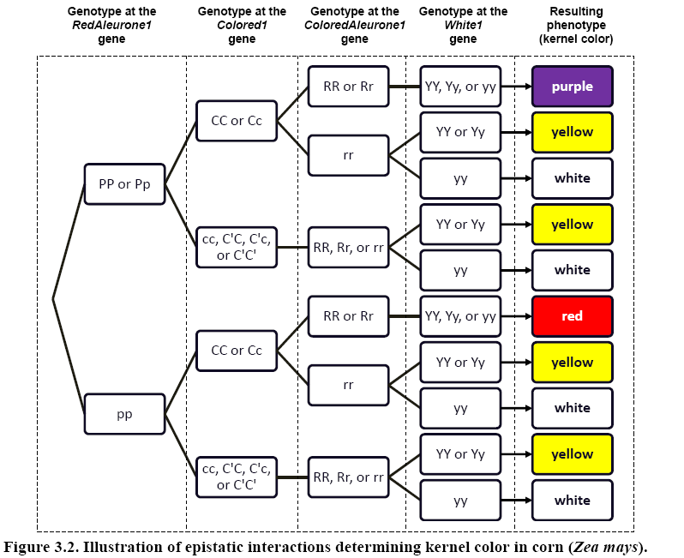
Exercise 3 - Epistasis

Slide 109
Exercise 3 - Epistasis
Using the information on the previous slides, answer the following questions:
Q1. In Exercise 2d, you may have guessed that kernel color in corn involves a single gene with two alleles, and a system of simple dominance. In fact, using the parental, F1, and F2 offspring ears, this appears to be the easiest explanation. Explain, in terms of genotypes and phenotypes, what may have led you to this original conclusion.
Q2. Using the tree diagram on the previous page, calculate the total number of genotypes that will result in each phenotype (kernel color).
HINT: Count the number of pathways one could take to achieve the kernel color of white, red, yellow and purple. (Note that some cells have multiple genotypes in them!)
Click to check answers, or click to go on.

Slide 110
Exercise 3 - Epistasis
Knowing what you now know about the epistatic determination of kernel color in corn, look at the ears of corn representing the three generations from the last exercise: parental, F1, and F2 generations. Use the tree and information provided on the 4 genes to answer the following questions:
Q3. Since you know what generation a particular corn ear belongs to in Exercise 2d, try to determine its genotype for each of the 4 kernel pigment alleles. How many pathways might lead to this color: for the parental type? For the F1 generation? For each kernel color in the F2 generation ear?
Q4. Can you think of some ways to help determine potentially unknown genotypes at certain genes of a particular corn kernel, aside from actually examining the kernel’s DNA?
Click to check your answers, or click to go on.

Slide 111
Exercise 3 - Epistasis
Now examine the additional ear of corn marked “Mystery Parents”.
Q5. What can you deduce about the parental phenotypes and genotypes that produced the ratio of kernel colors observed in this ear? You may wish to again consult Figure 5.2, as well as play around with a few Punnett squares to help you with this question. Don’t get discouraged if you can’t figure out everything about the possible genotypes of the parents, as the nature of epistatic interactions among genes in determining phenotypes can make things complicated! Just list everything you can determine for sure!
Click to check your answers, or click to go on.

Slide 112
Exercise 3 - Epistasis
Q6. A true-breeding plant is one that, when crossed with itself, always produces offspring with the same phenotype. In corn, there are multiple genotypes that are true-breeding for each color. Using the tree diagram, determine the #of genotypes that are true-breeding for each color, red, purple, yellow, & white.
Q7. Calculate the expected phenotype frequencies of the offspring resulting from a tetrahybrid cross in which both parents are heterozygous for all genes: PpCcRrYy × PpCcRrYy). HINT: There is an easier way to do this without drawing a humongous Punnett square! Use Figure 3.2, what you know about expected offspring phenotype ratios from a monohybrid cross, and the rules of probability from earlier in this unit!
Click to check your answers!

Slide 113
Exercise 3 - Epistasis
Answer to Q1:
In your sample F1 ear, you should have noticed that all of the offspring (individual kernels) were of the same color.
This should have led you to believe that both parents were homozygous: one homozygous for the dominant allele for one color, and one homozygous for the recessive allele for the other color.
In your F2 ear, which possesses offspring (individual kernels) of both colors, you might have noticed that the ratio of kernels of the “dominant” color to the “recessive” color were present in a ratio of approximately 3:1, which are the phenotype ratios we would expect in the outcome of a monohybrid cross (a cross between two F1 individuals, which would be heterozygous for the allele for color).

Slide 114
Exercise 3 - Epistasis
Q2. Using the tree diagram on the previous page, calculate the total number of genotypes that will result in each phenotype (kernel color).
Below is a table showing the total number of genotypes that will result in each kernel color. See the answer section in the workbook for a more detailed explanation at how to arrive at these answers.
Color | Number of Possible Genotypes
Purple | 24
Red | 12
Yellow | 84
White | 42

Slide 115
Exercise 3 - Epistasis
Q3. Imagine that you are given a single kernel of corn of a particular color. Based on its phenotype, can you determine its genotype (at each of the four previously discussed genes)? For which genes would you be able to certainly know the exact genotype for kernels of a particular color? Are there any genes for which you would be unable to completely deduce both alleles making up the genotype for that gene for each particular color? Why is this the case?
Normally, if we were examining a trait controlled by only one gene (let’s use a gene with two alleles, A and a, as an example), we would only know the genotype of the organism for that gene if it displayed the phenotype resulting from being homozygous recessive for that gene, because then we would know that the organism has to have two recessive alleles for that gene (genotype aa). If the organism displayed the dominant phenotype, we know that it would have at least one A allele, so it could actually be either genotype AA or Aa. We could thus write its genotype, showing our level of uncertainty as A?, where the question mark shows that we are not certain what the other allele possessed by the organism actually is.
If we were to examine a single kernel of corn of a particular color, it would be impossible to know its entire genotype for each of the genes mentioned in this exercise. The only genotypes we would be able to know for certain would be the genotype at the RedAleurone1 gene for a red kernel (pp), or the genotype at the White1 allele for a white kernel (yy), because the only way that either of these colors would be expressed would be if they had the homozygous recessive genotypes at the previously mentioned genes. We could write the possible genotypes of a red kernel as ppC?R???. We could write the possible genotypes for a white kernel as ??????yy. All we would know about a yellow kernel is that it has at least one Y allele for the White1 gene (and could be homozygous recessive at the Colored1 gene, cc, and/or the ColoredAleurone1 gene, rr, AND/OR have at least one C’ allele for the Colored1 gene). We could thus denote what we know for certain about a yellow kernel’s genotype as ??????Y?. A purple kernel would have to have at least one P allele, at least one C allele, AND at least one R allele. We could thus write what we know about its genotype as P?C?R???.

Slide 116
Exercise 3 - Epistasis
Q4. Can you think of some ways to help determine potentially unknown genotypes at certain genes of a particular kernel of corn, aside from actually examining the kernel’s DNA?
One possibility would be to look not only at the kernel of interest, but also at its siblings, or other kernels from the same cob, if they were available. By examining the phenotypes that are present in that particular batch of offspring, as well as the ratios in which those phenotypes were present, you could get a better idea of what alleles were contributed to each offspring by the parent plants that produced the ear, and thus a better idea of the possible genotypes of the offspring of each particular color.

Slide 117
Exercise 3 - Epistasis
If you were given a single kernel, you could grow an adult plant from it, and when mature, cross it with other corn plants of known genotypes. It would be helpful to cross the plant with a plant that “breeds true” for a color that is expressed only when kernels are homozygous recessive at the allele resulting in the production of that color (such as red, which has the genotype pp at the RedAleurone1 gene, or white, which has the genotype yy at the White1 gene).
By conducting this test cross, you could tell if your mystery kernel had at least one recessive allele for either of those genes if you saw either red or white kernels in the offspring. You could also further conduct crosses between two individuals from the offspring, cross the offspring with either of the parent plants, or conduct other crosses with plants of known genotypes, and look at the phenotypes (and their ratios) in those offspring to help you figure it out!

Slide 118
Exercise 3 - Epistasis
Also, if your kernel was either purple or red, you would not know anything about its genotype at the White1 gene, because the purple or red pigmentation in the aleurone masks the color of the endosperm inside. You could actually dissect the kernel to see what color its aleurone happened to be, at least letting you narrow down the possible genotypes of the kernel at that gene (and giving you a definite answer if the endosperm was white!).

Slide 119
Exercise 3 - Epistasis
Q5. Examine the ear of corn labeled “Mystery Parents” in your box. Based on the phenotypes of the kernels present, what can you deduce about the genotypes of the plants that were crossed to produce this ear? You may wish to consult Figure 4.2, as well as play around with a few Punnett squares to help you with this question! Don’t get discouraged if you can’t figure out everything about the possible genotypes of the parents, as the nature of epistatic interactions between genes in determining phenotypes can make things complicated! Just figure out everything that you are able to know for sure!
This answer will vary, based on the phenotypes present on your “Mystery Ear” of corn!

Slide 120
Exercise 3 - Epistasis
Q6. A true-breeding plant is one that, when crossed with itself, always produces offspring with the same phenotype. In corn, there are actually multiple genotypes that can be true-breeding for each color. How many genotypes would be true-breeding for each color?
Below is a table showing the total possible number of genotypes of each color of corn that would breed true for that particular color. See the answers section in the workbook for more detail on how to arrive at this answer.
Color | Number of True –Breeding Genotypes
Purple | 3
Red | 3
Yellow | 30
White | 30

Slide 121
Exercise 3 - Epistasis
Q7. Calculate the expected phenotype frequencies of the offspring resulting from a tetrahybrid cross (both parents are heterozygous for all genes: PpCcRrYy × PpCcRrYy).
Below is a table showing the expected phenotype frequencies of the offspring from a tetrahybrid cross. See the answers section of your workbook if you would like additional details on how to arrive at this answer.
Color | Proportion | % | Fraction | Ratio
Purple | 0.4219 | 42.19% | 27/64 | 27
Red | 0.1406 | 14.06% | 9/64 | 9
Yello | 0.3281 | 32.81% | 21/64 | 21
White | 0.1094 | 10.94% | 7/64 | 7

Slide 122
Exercise 4 – Human Genetics
Click on the underlined text below to jump to individual exercises exploring human genetics.
Exercise 4a: Inherited Traits: A Genetic Coin Toss?
Exercise 4b: Comparing Family Traits
Exercise 4c: Constructing a Pedigree

Slide 123
Exercise 4a – Inherited Traits: A Genetic Coin Toss?
Do you have freckles?
Whether or not you have freckles, as well as many other traits you possess, are the results of dominant and recessive alleles (different forms of the same genes) that are inherited from your parents and determined before you are born.
A dominant allele is one that is always expressed (observed if at least one copy of it is present).
A recessive allele is one whose trait is only observed if a child gets two copies of the recessive allele (one from each parent).
If a child gets a dominant allele from one parent, and a recessive allele from the other parent, the trait “coded” by the dominant allele “masks” the trait coded for by the recessive allele.
For example, freckles are the result of a dominant allele, while a lack of freckles is a recessive trait.
Many traits that humans possess are inherited. So, how likely is it that a person will end up with a certain trait?

Slide 124
Exercise 4a – Inherited Traits: A Genetic Coin Toss?
In this lesson, you will learn how inherited traits are determined.
You will use coins to help you understand how some people have certain traits and others in the same family might have different traits depending on the combination of genes from the parents.
Tossing coins results in different combinations depending on how the coins land.
If you are tossing two coins, and each coin can land on either heads or tails, how many different combinations are possible?
If you said 3, you are exactly right! The possible results of these tosses are as follows:
  Heads on both coins
  Tails on both coins
  Heads on one coin, and tails on the other (can happen 2 ways)
Go to the next slide for instructions on how to complete this exercise.

Slide 125
Exercise 4a – Inherited Traits: A Genetic Coin Toss?
Find a partner to work with on this exercise.
You and your partner will be tossing two coins at a time onto a flat surface and recording how they land.
You will need to make a table so you can show tally marks in the correct column to indicate how the coins landed for each toss. The table should look something like the one below:
Heads-Heads | Heads-Tails | Tails-Tails
% | % | %

Slide 126
Exercise 4a – Inherited Traits: A Genetic Coin Toss?
Toss the pair of coins 50 times and record your results for each toss with a tally mark in the appropriate column.
You may wish to toss the coins 25 times while your partner records the results, and then switch duties.
If your first toss gives you a heads-tails combination, put a tally mark in the heads-tails column, and repeat that procedure for each of your 50 tosses.
When you have tossed the pair of coins a total of 50 times, find the total number of tallies for each column. The three totals should have a sum of 50.
Find the percentage of each combination of tosses.
Example: 14 out of 50 = 14 ÷ 50 = 0.28 = 28%
Do the same for each total number of tosses for each of the three possible combinations.
Once you have your three percentages, the sum of those percentages should equal 100% to represent the whole set of tosses.

Slide 127
Exercise 4a – Inherited Traits: A Genetic Coin Toss?
After you have completed your 50 tosses of the pair of coins, answer the following questions:
  How do your percentages for the different combinations compare?
  Do the three percentages vary much in size?
  How do your percentages compare to other groups’ percentages? Are they similar?
In examining these percentages, what we are looking at is the probability of tossing a certain combination of heads and tails.
In other words, we are getting an idea of how likely is it that your two coins will land on any of the three possible combinations of heads and tails on any given toss of the two coins.
If you didn’t catch the connection between this exercise and the inheritance of traits, the next slide offers further information.

Slide 128
Exercise 4a – Inherited Traits: A Genetic Coin Toss?
Whether or not you possess a certain trait depends on the combination of alleles from your parents.
For a given trait, an individual has two alleles for that trait (one from their mother, and one from their father).
This could be two dominant alleles, two recessive alleles, or one of each, depending on which alleles each parent has.
For example, if one parent has only two recessive alleles, they can only pass on a recessive allele to each child they have.
  To further relate this to coins, this would be like the one coin that represents that parent having two tails However, if a parent has one dominant and one recessive allele, they could pass on either of those two to each child (a coin with heads and tails).
This is why, if you have one parent with freckles, and one parent without, you may have freckles while a brother or sister does not.
The probability of having a particular trait depends on the combination of genes for that trait from your parents.

Slide 129
Exercise 4b – Comparing Family Traits
In this activity, you will explore the inheritance of traits by creating a description of yourself based on several traits.
You are also going to list traits of two other members of your family, like parents, grandparents, or other relatives.
You will then compare the description of yourself to the descriptions of your family members, and use this information to help you think about how those traits might be inherited.
On a blank sheet of paper, divide the sheet into four columns and draw lines down the paper to separate the columns.
The first column will be the inherited traits you will compare between family members. Write “Traits” at the top of this column.
Write your name at the top of the second column.
Write the name of one family member at the top of the third column.
Write the name of the other family member at the top of the fourth column.

Slide 130
Exercise 4b – Comparing Family Traits
Under the column labeled “Traits,” list several easily-observed traits that are of interest to you. Try to think of at least 3-5 traits to examine in yourself and your chosen family members.
If you or a family member have a particular trait, write “yes” in the table in the row representing that trait. If you or a family member do not possess a certain trait, write “no” in the row representing that trait. Alternatively, if you are examining a trait that might take several forms (like hair color or eye color), you may assign simple descriptor words for these traits.
Complete as much of the table as possible in class, then take the list home to complete for family members since you may need to be with the family members to examine their traits.
Compare your findings with the class and share unusual or interesting things you found out about your family’s traits.
Now think about and discuss the following questions:
  Are there similarities among traits in your family?
  What differences did you find?

Slide 131
Exercise 4b – Comparing Family Traits
Now let’s look back at the earlier example of freckles.
Your teacher will poll the class to find out the number of students in the class with and without freckles.
Look first at the number of students with freckles.
  Does the number represent most of the class, or a small portion of the class?
Using a ratio, compare the number of students with freckles to the total number of students.
For instance, if there are 28 students in the class and 7 of those students have freckles, the ratio will be 7:28.
Using that ratio, find the percentage of students in your class that have freckles.
Example: Using the 7:28 ratio, we would divide 7 by 28, for a quotient of 0.25, which is 25%, meaning 25% of the students in your class have freckles.

Slide 132
Exercise 4b – Comparing Family Traits
Now answer the following questions. You may need to do a bit of library and/or internet research to find the answers!
Q1: Are dominant traits always the most common traits in a
population?
Q2: Why do you think this might be the case?
Q3: Did your results suggest that the traits you selected are
inherited in simple dominant/recessive fashion, or do they
possibly indicate a more complex pattern, or environmental influences?
Q4: How might it be difficult to answer the previous question
above based on your results?
Q5: Can you think of a way you could get a better idea of how a
particular trait might be inherited?
Go on to the next slides for the answers to these questions.

Slide 133
Exercise 4b – Comparing Family Traits
Q1: Are dominant traits always the most common
traits in a population?
Click for the answer!
Though it is a common misconception, dominant traits are not always necessarily more common than recessive traits. Many people are confused by the terms “dominant” and “recessive”, and assume that “dominant” traits are ones that are always most common. However, these terms refer ONLY to how the traits are inherited, and not how prevalent they are in a population!

Slide 134
Exercise 4b – Comparing Family Traits
Q2: Why do you think this might be the case?
Click for the answer!
If a recessive allele is very common in a population, then the recessive trait will most likely be more frequently observed than the dominant trait. Also, consider certain diseases, or abnormalities caused by deleterious (harmful) mutations. Many of these are encoded by dominant alleles. However, the frequency of the dominant allele is then typically reduced dramatically due to selection against it. In this way, a trait “coded for” by a dominant allele can still be very rare in a population!

Slide 135
Exercise 4b – Comparing Family Traits
Q3: Did your results suggest that the traits you selected are inherited in simple dominant/recessive
fashion, or do they possibly indicate a more
complex pattern, or environmental influences?
Click for the answer!
Your answer might vary substantially here, depending on the traits you chose, as well as the family members whose traits you chose to examine.

Slide 136
Exercise 4b – Comparing Family Traits
Q4: How might it be difficult to answer the previous
question above based on your results?
Click for the answer!
Though the small amount of data you collected on your chosen traits can be informative, it is unlikely to be enough evidence to support a description of the mechanisms of inheritance of your chosen traits.

Slide 137
Exercise 4b – Comparing Family Traits
Q5: Can you think of a way you could get a better idea of how a
particular trait might be inherited?
Click for the answer!
Modern knowledge and technological advances in genetic analysis definitely facilitate further determination of how traits are inherited. However, one way that this question has been addressed for many years is through the construction of a pedigree, or a chart that shows relationships of individuals (usually of several generations), and the occurrence/absence of those traits indicated on the individuals represented in the chart. Click the forward arrow below to go on to instructions for Exercise 4c, in which you will explore the inheritance of traits by constructing a pedigree, or click the back arrow to go back to the main page for Exercise 4.

Slide 138
Exercise 4c – Constructing a Pedigree
How do scientists know whether a trait is dominant or recessive, or if the trait is even inherited in a simple dominant/recessive way?
One way of doing this is by constructing a pedigree.
A pedigree is a type of chart that illustrates relationships between individuals, as well as the presence or absence of a trait in those individuals.
Typically, pedigrees are tree-like diagrams, with different shapes (often circles and squares) representing individuals of different genders.
  Circles usually represent females.
  Squares usually represent males.

Slide 139
Exercise 4c – Constructing a Pedigree
On a pedigree, some of the shapes are joined by lines to show relationships.
A horizontal line connecting two shapes typically represents a mating between two individuals.
A vertical line descending from the horizontal line representing the mating shows the next generation, made up of the mated couple’s offspring.
When examining a specific trait, the circles and squares representing individuals possessing a particular trait are usually colored in.
By examining the occurrence of traits within families in a pedigree, scientists can often get a clue as to whether a trait is dominant or recessive, or if it is inherited in a different way.
Go to the next slide for an example of a pedigree.

Slide 140
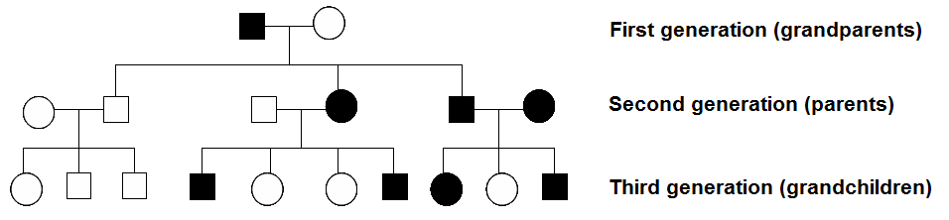
Exercise 4c – Constructing a Pedigree
Squares = males
Circles = females

Slide 141
Exercise 4c – Constructing a Pedigree
Horizontal lines connecting shapes = matings
The line indicated below represents a mating from the two individuals representing the first generation.
Vertical lines = offspring from a mating
The individuals indicated below are the three offspring produced by the first generation.
The vertical line from the mating between first generation individuals represents offspring produced by the first generation.
Horizontal lines connecting vertical lines = sibling relationships

Slide 142
Exercise 4c – Constructing a Pedigree
Shaded or filled shapes represent individuals that possess a trait of interest.

Slide 143
Exercise 4c – Constructing a Pedigree
How does a pedigree give us clues about how a trait is inherited?
In the pedigree pictured above, the trait of interest is likely a dominant trait, if it is inherited with a simple Mendelian basis.
Notice that the trait of interest does not skip any generations.
Also, if the trait was recessive, the parents represented by the dark square and dark circle could not have had the daughter without the trait.

Slide 144
Exercise 4c – Constructing a Pedigree
Pick a trait that is easily observed in individuals.
Draw your own pedigree, showing the occurrence of your chosen trait in your family.
Do not worry if you can’t figure out information from too many generations back, or if it would be difficult for you to get information on particular family members. Families are all very different, and as a result, some students’ pedigrees may be more extensive than others. Just do as much as you can, and with which you feel comfortable.
Some creative ways of helping you fill in your pedigree might be to talk to your oldest living relatives, looking at old family photos, etc.

Slide 145
Exercise 4c – Constructing a Pedigree
After constructing your pedigree, look over it and examine the patterns of occurrence of your chosen trait over the generations represented in your chart. You may wish to use information from several exercises in this book to help you with your genetic detective work!
Try to answer the following questions:
  Do you think your chosen trait is dominant or recessive, or do you think it might be inherited in a more complex way?
  Can you find other pedigrees (online, in the library, etc.) that show similar patterns that support your conclusions?
If your chosen trait seems to be one that is inherited in a more complex way, do a little additional research on that particular mode of inheritance.
Put together what you learned, and share it with the rest of your class in a brief presentation.

Slide 146
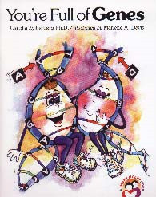
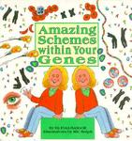
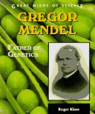
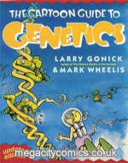
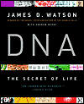
Suggested Reading
Grades K-3
You're Full of Genes - Claudia Zylberberg
Gregor Mendel: The Friar Who Grew Peas - Cheryl Bardoe
Grades 4-7
Have a Nice DNA - Frances R. Balkwill and Mic Rolph
Double Talking Helix Blues - Joel Herskowitz & Judy Cuddihy (Illustrator)
National Geographic Investigates: Genetics: From DNA to Designer Dogs - Kathleen Simpson
Amazing Schemes Within Your Genes - Frances R. Balkwill and Mic Rolph (Illustrator)
Crime Scene: True-life Forensic Files #1: Dusting and DNA - D.B. Beres and Anna Prokos
They Came from DNA - Billy Aronson & Danny O'Leary (Illustrator)
Gregor Mendel: Father of Genetics - Roger Klare

Slide 147
Suggested Reading
Grades 7+
The Cartoon Guide to Genetics - Larry Gonick & Mark Wheelis
The Human Genome Project: Cracking the Code Within Us - Elizabeth L. Marshall
New Genetics: The Study of Lifelines - Jerry S. Kidd & Renee A. Kidd
Genetic Engineering: Progress or Peril? - Linda Tagliaferro
Diabetes (Genes and Disease) - Toney Allman
Genetics and Genetic Engineering - Lisa Yount
Genetics and Evolution: The Molecules of Inheritance - Jill Bailey
DNA Analysis (Forensics: The Science of Crime-Solving) - William Hunter
Guilty By a Hair!: Real-life DNA Matches! - Anna Prokos (CAUTION: Contains information on cases involving violent crime, such as murder.)
The Making of the Fittest: DNA and the Ultimate Forensic Record of Evolution – Sean B. Carroll
DNA: The Secret of Life – James D. Watson & Andrew Berry
The Double Helix - James D. Watson
Understanding DNA: The Molecule & How It Works - Chris R. Calladine, Horace Drew, Ben Luisi, and Andrew Travers (actually a college textbook)
Scientific Journal Articles (included on Teacher CD!)
Han, B. And D. L. Denlinger. 2009. Mendelian inheritance of pupal diapause in the flesh fly, Sarcophaga bullata. Journal of Heredity 100(2):251-255.
Mendel, Gregor. 1866. Versuche über Plflanzenhybriden (Experiments in Plant Hybridization). Verhandlungen
des naturforschenden Vereines in Brünn, Bd. IV für das Jahr 1865, Abhandlungen, 3–47. (An updated English translation of the original is provided!)
Pennisi, E. 1996. Studly sheep by non-Mendelian means. Science, New Series 272(5265):1099-1100.
Watson, J.D. and F.H.C. Crick. 1953. Molecular structure of nucleic acids – A structure for deoxyribose nucleic acid. Nature 171(4356):737-738.

Slide 148
Links (All underlined text is clickable!)
The Gene Scene - The Genetics homepage on the American Museum of Natural History's OLogy site for kids. Lots of great introductory information on genetics, DNA, heredity, and other related topics. Includes several crafts, as well as an directions for extracting a clump of goopy DNA from an onion, using only simple household materials!
Biology4Kids.com: Cell Structure - Great site with information on cell structure and function, including discussions of DNA, chromosomes, etc. (Particularly check out the sections on the nucleus, chromosomes, centrioles, and ribosomes!)
The Structure of the DNA Molecule - This "Access Excellence" website from the National Health Museum contains a brief (but informative) history of Mendel's experiments, as well as Watson and Crick's discovery of the shape of the DNA molecule, as well as a glossary, nice graphics, and a few classroom activities.
Patterns of Inheritance - Good website providing basic genetics terminology, information on the genetics of eye color in humans, a "genetic puzzle" to determine a family's genotypes based on phenotypes, and details on formation of gametes during meiosis.
Basic Principles of Genetics - A good overview site by the Behavioral Sciences Department at Palomar College, including great information on basic Mendelian genetics, the probability of inheritance (includes a good intro to the use of Punnett squares), and exceptions to simple inheritance. Also includes practice quizzes, flashcards, and a fun crossword puzzle, as well as a glossary and links.
Genome: The Secret of How Life Works - A visually appealing and informative site from Pfizer, which includes "informative and interactive content for anyone with a genome." Yes, that means you. Includes games, quizzes, and even lesson plans at both the elementary and high school levels, as well as a nice compilation of links. The entire website is also available in Spanish.
Learn.Genetics - Beautiful and HUGE website from the University of Utah containing information on genetic technology, virtual labs, resources and lesson plans for teachers, information on genetic disorders, epigenetics, and even such interesting topics as molecular genealogy and the genetics of addiction.
Genetics Education Center - A great comprehensive compilation of links from the University of Kansas Medical Center, including multiple links on the Human Genome Project, genetic education resources, activities, museums with genetics exhibits, and more!

Slide 149
Links (All underlined text is clickable!)
Patterns of Inheritance - Good information with details on mechanisms of inheritance, including dominance and recessiveness, codominance, and multiple alleles, in the context of budgerigars (parakeets) and other parrots, from BirdHobbyist.com. May be of particular interest to those with pet birds at home!
Feline Genome Project: Coat Colors & Fur Types - Have cats at home? Ever wondered what color kittens they could have? This site, from the College of Veterinary Medicine at UC Davis, is the place to find out.
Dog Coat Color Genetics - Since we mentioned pet genetics, we couldn't leave out man's best friend! This site from the University of Saskatchewan gives "a brief review of the genes controlling dog coat colors and patterns, as well as coat type".
MendelWeb - A great resource for teachers and students interested in "the origins of classical genetics, introductory data analysis, elementary plant science, and the history and literature of science." Also includes PDF versions of Mendel's original paper (in German), as well as an updated, revised, English translation (which is also included on the teacher CD), and lots of other good genetics links!
Mendelian and Non- A good description of terminology used regarding Mendelian and non-Mendelian patterns of inheritance by Ken Parejko at the University of Wisconsin Stout.
Mendelian Inheritance Patterns in Humans – A past project conducted by several participating schools. Though the links on this page no longer work, it may serve as a good source of inspiration for exploring the genetics of several traits that students can easily observe in themselves and their families.
List of Mendelian traits in humans – Wikipedia article listing several traits in humans that have Mendelian patterns of inheritance, as well as several that were previously thought to be Mendelian, but probably have a more complex genetic basis.
Online Mendelian Inheritance in Man - A comprehensive database of human genes and phenotypes from the National Center for Biotechnology Information (NCBI). Pretty heavy-duty, so probably most appropriate for advanced high school classes.
Myths of Human Genetics - Website exploring commonly held misconceptions about human traits previously thought be inherited in a simple Mendelian fashion.

